Slide 1
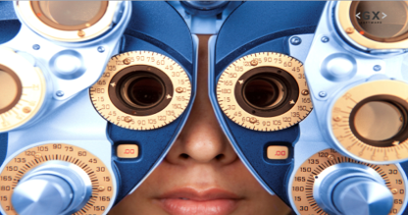
Discover associations
Natasja Fortuin, Oct. 2019

Slide 2
Summary
Are there any interesting patterns & associations between customer’s transactions and the item(s) they’ve purchased that can help decide whether or not to take over Electronidex.
Customer pivot
provide actionable insights to fuel campaigns & increase sales by knowing and influencing the customer and its behaviour in-store & online and deliver a personal experience. Segment them & measure & analyse all activities while building data.
Expand data & tools to learn & influence
introduce VIP card, implement real-time segmentation and recommendation online, start search for look-a-likes & responders in profiles and identify products often bought together.
Learn & build on knowledge how to predict future
on factors that play a role based on the results wanted

Slide 3
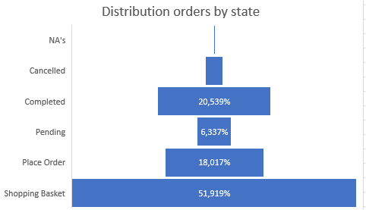
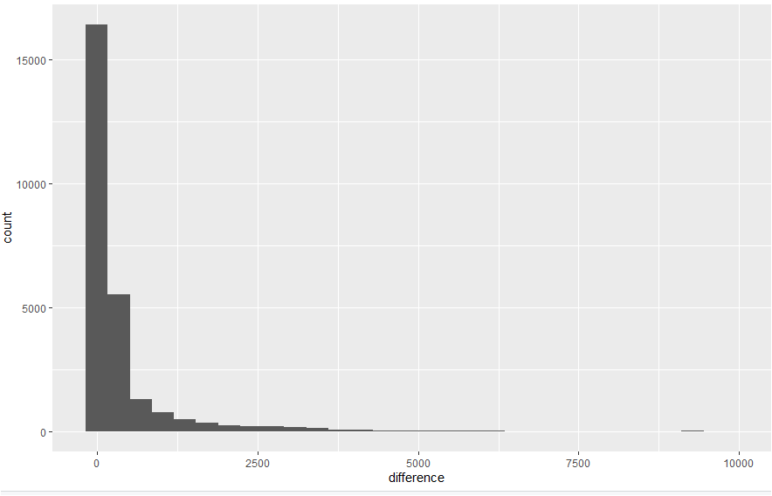
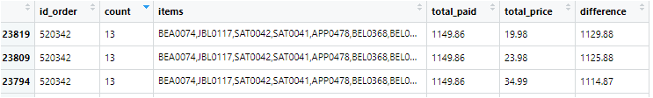

Order, product, transaction analysis
For the analysis we analyzed all online (completed - 21%) orders and used transaction data and product detail information to get an overview of unique orders with more than 2 items purchased together.
We completed that information with what was paid online and what the price would have been based on unit price information and amount of items bought.
It needs to be noted that we found for a moderate part of the data a price difference between the amount paid and what should be paid. Sometimes substantial amounts, sometimes almost insignificant. This needs to be investigated further.

Slide 4
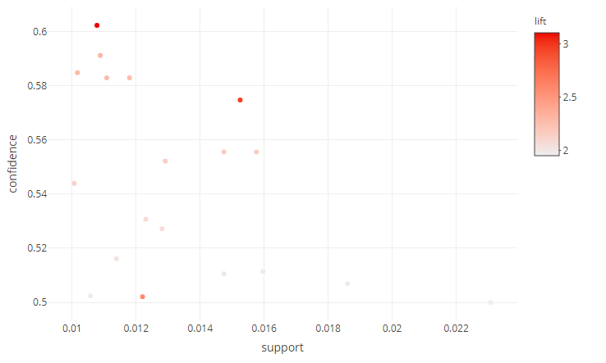
Relationships between products
With a Market Basket Analysis the relationship between products are analyzed. Although we have not found a very strong relationship between products yet, results are promising enough to deeper investigate the data and relationships between product. The preliminary results are pointed out on below.
The higher the frequency of products bought together (support), it becomes more unlikely that this combination of products gets purchased (confidence).
Market Basket analysis
Support 0.01, Confidence 0.50 gives 19 possible combinations

Slide 5
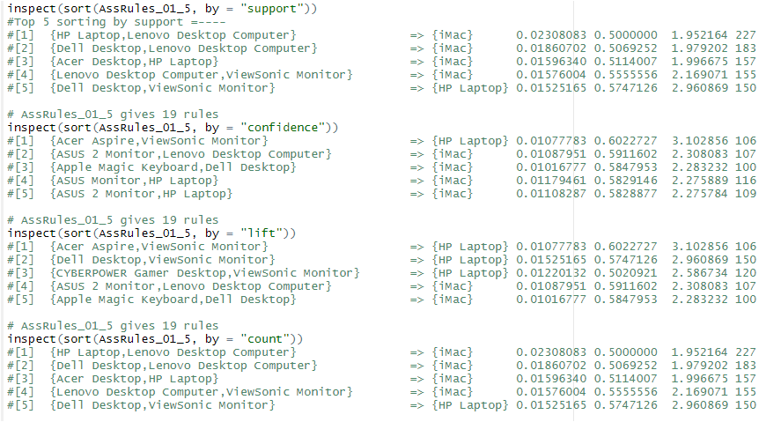
Top 5 sorted by importance of measurement
iMac and HP Laptop are likely to be considered for purchase in general.
Market Basket analysis
Support 0.01, Confidence 0.50 gives 19 possible combinations

Slide 6
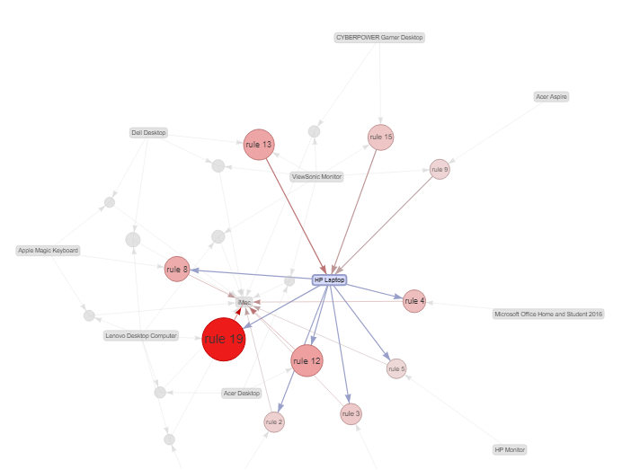
Rules connected to HP Laptop by importance
iMac and HP Laptop are likely to be considered for purchase in general.
Market Basket analysis
Support 0.01, Confidence 0.50 gives 19 possible combinations

Slide 7
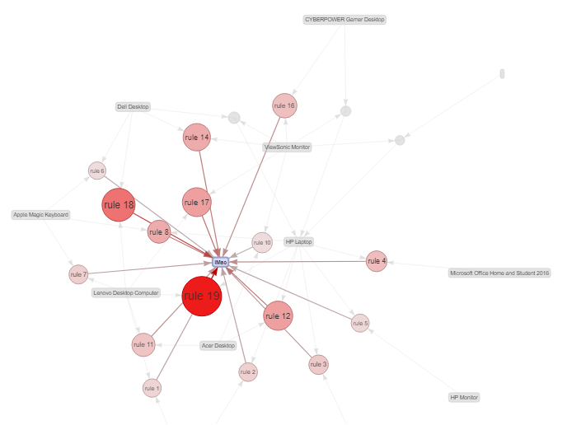
Rules connected to iMac by importance
iMac and HP Laptop are likely to be considered for purchase in general.
Market Basket analysis
Support 0.01, Confidence 0.50 gives 19 possible combinations

Slide 8
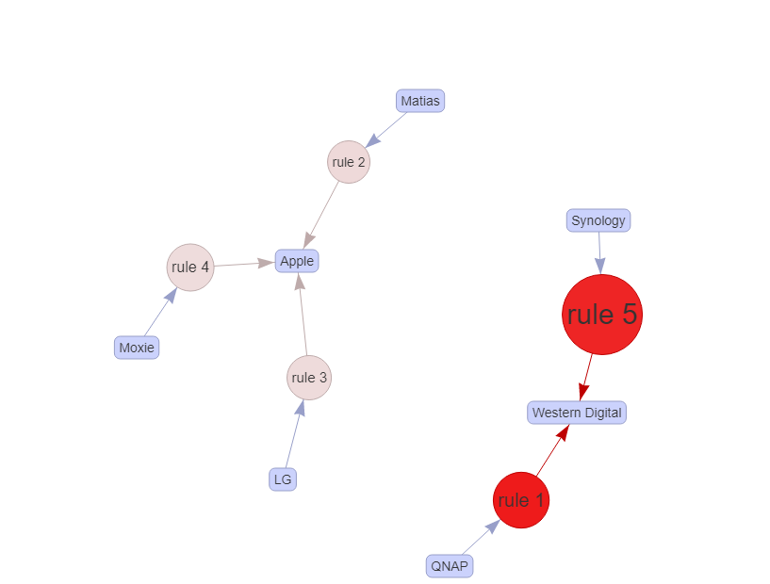
Rules based on brand name analysis
89% of the customers who bought QNAP also bought ‘Western Digital’ products like hard-drive, my book, my cloud server, my passport. All are accessoires that can be combined with a Mac.
86% of the customers who bought Synology Digital also bought
‘Western Digital’. Both are accessories for Mac , PC’s, and camera’s.
lhs rhs support confidence lift count
[1] {QNAP} => {Western Digital} 0.03003635 0.8895184 9.421505 314
[2] {Matias} => {Apple} 0.02544481 0.7687861 1.983927 266
[3] {LG} => {Apple} 0.02611441 0.7459016 1.924872 273
[4] {Moxie} => {Apple} 0.02707098 0.7201018 1.858293 283
[5] {Synology} => {Western Digital} 0.03826287 0.8639309 9.150490 400
Market Basket analysis
Support 0.025, Confidence 0.70 gives 5 rules

Slide 9
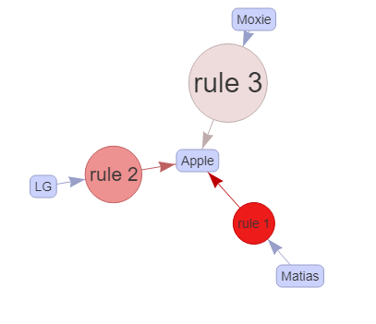
RHS
89% of the customers who bought QNAP also bought ‘Western Digital’ products like hard-drive, my book, my cloud server, my passport. All are accessories that can be combined with a Mac.
86% of the customers who bought Synology Digital also bought
‘Western Digital’. Both are accessories for Mac , PC’s, and camera’s.
What about products that will result in buying an Apple product (2,3,4)
Customers buying Matias, LG, Moxie are likely to also buy an Apple product.
lhs rhs support confidence lift count
[1] {QNAP} => {Western Digital} 0.03003635 0.8895184 9.421505 314
[2] {Matias} => {Apple} 0.02544481 0.7687861 1.983927 266
[3] {LG} => {Apple} 0.02611441 0.7459016 1.924872 273
[4] {Moxie} => {Apple} 0.02707098 0.7201018 1.858293 283
[5] {Synology} => {Western Digital} 0.03826287 0.8639309 9.150490 400
Market Basket analysis
Support 0.025, Confidence 0.70 gives 5 rules

